Slide 1
Twitter Score Dashboard
Luke McNamara

Slide 2
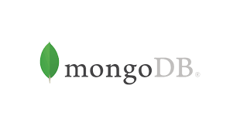


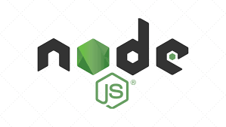
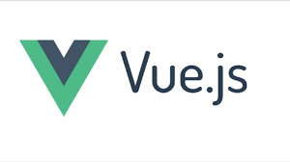
Project Tools
Twitter’s API
NodeJS
VueJS
MongoDB
Heroku
Vuexy (Future Implementation)

Slide 3
Future Implementation
Unfortunately did not get to Vuexy due to conflicting time constraints as a new product
User Authentication - Easily handled through Vuexy with something like Auth0, Firebase, or JWT
Making a Twitter API call using a user search query to generate Twitter Analytics

Slide 4
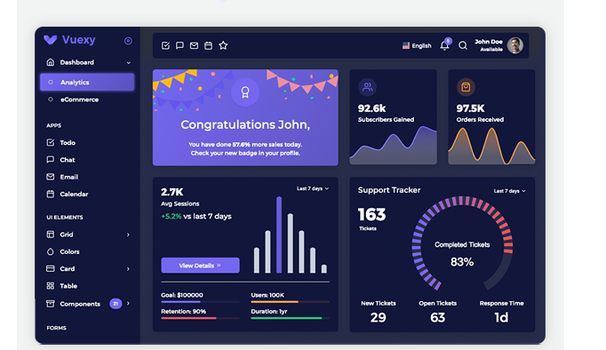
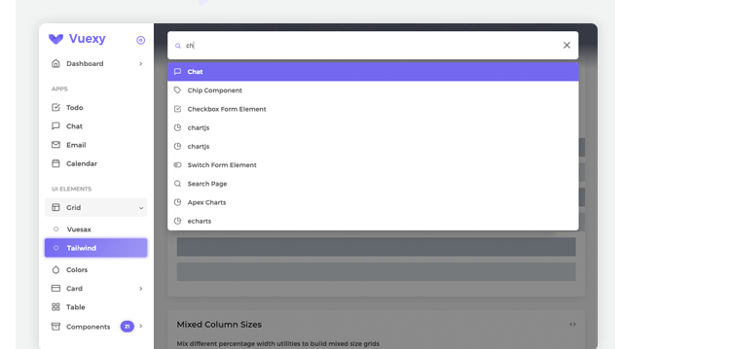
Vuexy
Dashboard tool that would have been used to make our application “prettier”
Unfortunately did not have time to implement due to how many features it has to offer so we opted for a first version using raw VueJS
Here is an example dashboard page for an ecommerce site:

Slide 5
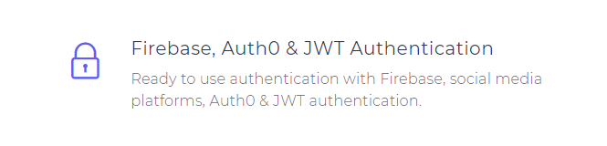
User Authentication
Since we did not get to implementing Vuexy, we also did not have a way to authenticate the user as we spent most of our time fleshing out the main purpose of the application (to make an API call to find and score tweets based on a simple algorithm and chart it on a webpage)

Slide 6
Twitter API Call through Search Query
This was something I really wanted to implement, however it proved fairly difficult as Twitter’s API documentation is very difficult to grasp so I spent longer learning how to do it than I would have liked.
Letting people be able to see an account’s metrics based on what they search was the main goal of this project, however this function proved very difficult and did not fit within the scheduled scope of the process

Slide 7
Looking Forward
Ways to iterate on this project moving forward includes:
Utilizing different social media sites (Instagram, Facebook, Reddit, YouTube, etc.)
Coming up with new and interesting scoring algorithms to handle what kind of metrics you want to look at
Coming up with some kind of service model for our site if users only want access to certain functions

Slide 8
Conclusion
Project Scope and how the process unfolded
Limitations of scope and build with limited resources (time, people, money, etc)
Too much to take on (not utilizing some easier tools for certain parts of the project)
Moving forward with the build of the project

